Slide 1
PHP – Functions
A simple function declaration
<?php
function time_machine($a)
{
echo time() + $a;
}
?>
This call uses the built-in PHP time function to fetch the current timestamp
Timestamp: an integer number representing a date and time based on the number of seconds since 00:00 a.m. on January 1, 1970

Slide 2
PHP – Variable Scope
Local variables are variables that are created within, and can be accessed only by, a function.
They are generally temporary variables that are used to store partially processed results prior to the function’s return
Example:
<?php
function longdate($timestamp)
{
$temp = date("l F jS Y", $timestamp);
return "The date is $temp";
}
?>
Here we have assigned the value returned by the date function to the temporary variable $temp, which is then inserted into the string returned by the function.
As soon as the function returns, the value of $temp is cleared, as if it had never been used at all.

Slide 3
PHP – Variable Scope
<?php
$temp = "The date is ";
echo longdate(time());
function longdate($timestamp)
{
return $temp . date("l F jS Y", $timestamp);
}
?>
Here $temp has been created before we call the longdate function.
However, because $temp was neither created within the longdate function nor passed to it as a parameter, longdate cannot access it. Therefore, this code snippet outputs only the date, not the preceding text

Slide 4
PHP – Variable Scope
Let’s see some ways to repair the previous code
// Rewriting to refer to $temp within its local scope fixes the problem
<?php
$temp = "The date is ";
echo $temp . longdate(time());
function longdate($timestamp)
{
return date("l F jS Y", $timestamp);
}
?>
The code here moves the reference to $temp out of the function.
The reference appears in the same scope where the variable was defined.

Slide 5
PHP – Variable Scope
//An alternative solution: passing $temp as an argument
<?php
$temp = "The date is ";
echo longdate($temp, time());
function longdate($text, $timestamp)
{
return $text . date("l F jS Y", $timestamp);
}
?>
The solution showed here passes $temp to the longdate function as an extra argument.
longdate reads it into a temporary variable that it creates called $text and outputs the desired result.

Slide 6
Global variables
To declare a variable as having global scope, use the keyword global
Let’s assume that you have a way of logging your users into your website and want all your code to know whether it is interacting with a logged-in user or a guest.
One way to do this is to create a global variable such as $is_logged_in:
global $is_logged_in;

Slide 7
Global variables
You should use global variables with caution, though.
I recommend that you create them only when you absolutely cannot find another way of achieving the result you desire.
If you have a thousand-line program (and some day you will) in which you discover that a global variable has the wrong value at some point, how long will it take you to find the code that set it incorrectly?
Also, if you have too many global variables, you run the risk of using one of those names again locally, or at least thinking you have used it locally, when in fact it has already been declared as global.
In general, programs that are broken into small parts and segregated data are less buggy and easier to maintain.
Notes:
To make global variables more visible, try making their names uppercase

Slide 8
Static Variable
//A function using a static variable
<?php
function test() {
static $count = 0;
echo $count;
$count++;
}
?>
Here the very first line of function test creates a static variable called $count and initializes it to a value of 0.
The next time the function is called, because $count has already been declared, the first line of the function is skipped.
Then the previously incremented value of $count is displayed before the variable is again incremented.

Slide 9
Static Variable
If you plan to use static variables, you should note that you cannot assign the result of an expression in their definitions
They can be initialized only with predetermined values.
//Allowed and disallowed static variable declarations
<?php
static $int = 0; // Allowed
static $int = 1+2; // Disallowed (will produce a Parse error)
static $int = sqrt(144); // Disallowed
?>

Slide 10
Superglobal variables
Starting with PHP 4.1.0, several predefined variables are available.
These are known as superglobal variables, which means that they are provided by the PHP environment but are global within the program, accessible absolutely everywhere.
These superglobals contain lots of useful information about the currently running program and its environment
They are structured as associative arrays

Slide 11
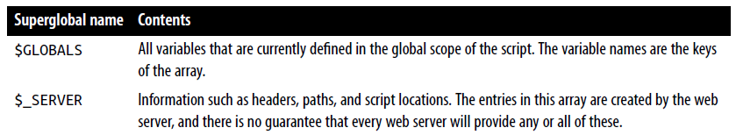
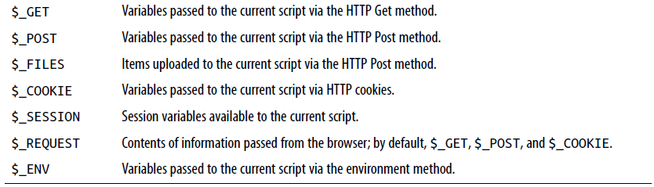

Slide 12
Superglobal Variables
All of the superglobals (except for $GLOBALS) are named with a single initial underscore and only capital letters
Therefore, you should avoid naming your own variables in this manner to avoid potential confusion.
Example: The URL of the page that referred the user to the current web page.
$came_from = $_SERVER['HTTP_REFERER’];
Oh, and if the user came straight to your web page, such as by typing its URL directly into a browser, $came_from will be set to an empty string.

Slide 13
Superglobals and security
A word of caution is in order before you start using superglobal variables, because they are often used by hackers trying to find exploits to break into your website.
What they do is load up $_POST, $_GET, or other superglobals with malicious code, such as Unix or MySQL commands that can damage or display sensitive data if you naïvely access them.
Therefore, you should always sanitize superglobals before using them.

Slide 14
Superglobals and security
One way to do this is via the PHP htmlentities function.
It converts all characters into HTML entities
For example, less-than and greater-than characters (< and >) are transformed into the strings &lt; and &gt;
So that they are rendered harmless, as are all quotes and backslashes, and so on.

Slide 15
Superglobals and security
Therefore, here is a much better way to access $_SERVER (and other superglobals) is:
$came_from = htmlentities($_SERVER['HTTP_REFERER']);
Using the htmlentities function for sanitization is an important practice in any circumstance where user or other third-party data is being processed for output, not just with superglobals.
DO THIS!

Slide 16
Expressions and Control Flow in PHP
Let’s start with the most fundamental part of any programming language: expressions
An expression is a combination of values, variables, operators, and functions that results in a value.
y = 3(abs(2x) + 4)
which in PHP would be:
$y = 3 * (abs(2 * $x) + 4);
The value returned (y, or $y in this case) can be a number, a string, or a Boolean value

Slide 17
Expressions and Control Flow in PHP
TRUE or FALSE?
A basic Boolean value can be either TRUE or FALSE.
For example, the expression 20 > 9 (20 is greater than 9) is TRUE, and the expression 5 == 6 (5 is equal to 6) is FALSE.
You can combine Boolean operations using operators such as AND, OR, and XOR, which are covered later
NOTE: I am using uppercase letters for the names TRUE and FALSE
This is because they are predefined constants in PHP. You can also use the lowercase versions, if you prefer, as they are also predefined.
In fact, the lowercase versions are more stable, because PHP does not allow you to redefine them; the uppercase ones may be redefined—something you should bear in mind if you import third-party code.

Slide 18
Expressions and Control Flow in PHP
<?php
echo "a: [" . (20 > 9) . "]<br>";
echo "b: [" . (5 == 6) . "]<br>";
echo "c: [" . (1 == 0) . "]<br>";
echo "d: [" . (1 == 1) . "]<br>";
?>
This example shows some simple expressions:
The two I just mentioned, plus a couple more. For each line, it prints out a letter between a and d, followed by a colon and the result of the expressions.
The <br> tag is there to create a line break and thus separate the output into four lines in HTML.

Slide 19
A hidden note
Now that we are fully into the age of HTML5, and XHTML is no longer being planned to supersede HTML, you do not need to use the self-closing <br /> form of the <br> tag, or any void elements (ones without closing tags), because the / is now optional.
Therefore, I have chosen to use the simpler style here. If you ever made HTML nonvoid tags self-closing (such as <div />), they will not work in HTML5 because the / will be ignored, and you will need to replace them with (for example) <div>...</div>.
However, you must still use the <br /> form of HTML syntax when using XHTML.

Slide 20
Expressions and Control Flow in PHP
<?php
echo "a: [" . (20 > 9) . "]<br>";
echo "b: [" . (5 == 6) . "]<br>";
echo "c: [" . (1 == 0) . "]<br>";
echo "d: [" . (1 == 1) . "]<br>";
?>
The output from this code is as follows:
a: [1]
b: []
c: []
d: [1]
Notice that both expressions a: and d: evaluate to TRUE, which has a value of 1.
But b: and c:, which evaluate to FALSE, do not show any value, because in PHP the constant FALSE is defined as NULL, or nothing

Slide 21
Expressions and Control Flow in PHP
To verify this for yourself, you could enter this code:
<?php // test2.php
echo "a: [" . TRUE . "]<br>";
echo "b: [" . FALSE . "]<br>";
?>
that outputs the following:
a: [1]
b: []
Notes:
By the way, in some languages FALSE may be defined as 0 or even –1, so it’s worth checking on its definition in each language.

Slide 22
Literals and Variables
The simplest form of an expression is a literal, which simply means something that evaluates to itself, such as the number 73 or the string "Hello".
An expression could also simply be a variable, which evaluates to the value that has been assigned to it.
They are both types of expressions, because they return a value.

Slide 23
Literals and Variables
This snippet shows three literals and two variables, all of which return values, albeit of different types.
<?php
$myname = "Brian";
$myage = 37;
echo "a: " . 73 . "<br>"; // Numeric literal
echo "b: " . "Hello" . "<br>"; // String literal
echo "c: " . FALSE . "<br>"; // Constant literal
echo "d: " . $myname . "<br>"; // String variable
echo "e: " . $myage . "<br>"; // Numeric variable
?>

Slide 24
Literals and Variables
And, as you’d expect, you see a return value from all of these with the exception of c:, which evaluates to FALSE, returning nothing in the following output:
a: 73
b: Hello
c:
d: Brian
e: 37

Slide 25
Literals and Variables
In conjunction with operators, it’s possible to create more-complex expressions that evaluate to useful results.
When you combine assignment or control-flow constructs with expressions, the result is a statement.
<?php
$days_to_new_year = 366 - $day_number; // Expression
if ($days_to_new_year < 30)
{
echo "Not long now till new year"; // Statement
}
?>
Notes:
The first assigns the result of the expression 366 - $day_number to the variable $days_to_new_year, and the second outputs a friendly message only if the expression $days_to_new_year < 30 evaluates to TRUE

Slide 26
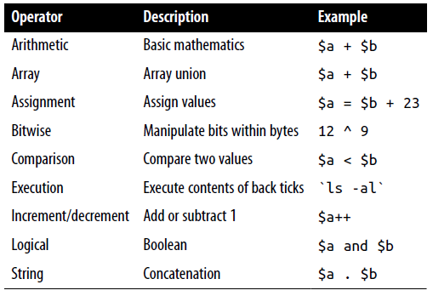
Operators
PHP offers a lot of powerful operators that range from arithmetic, string, and logical operators to assignment, comparison, and more

Slide 27
Operators
Each operator takes a different number of operands:
Unary operators, such as incrementing ($a++) or negation (-$a), which take a single operand.
Binary operators, which represent the bulk of PHP operators, including addition, subtraction, multiplication, and division.
One ternary operator, which takes the form ? x : y. It’s a “single-line if statement” that chooses between two expressions, depending on the result of a third one.

Slide 28
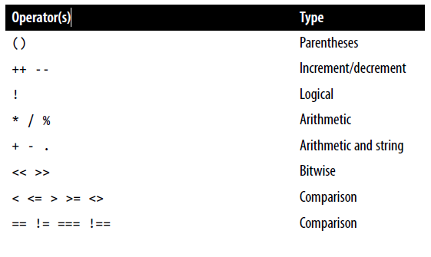
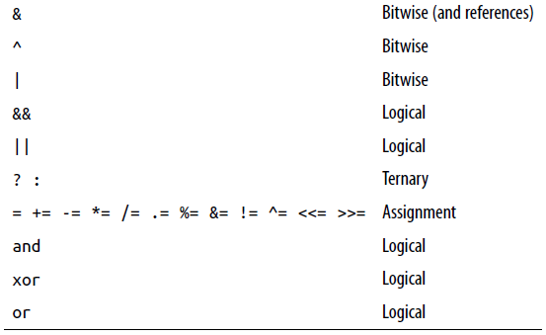
Operators
Precedence of PHP operators (high to low):

Slide 29
Relational Operators
Relational operators test two operands and return a Boolean result of either TRUE or FALSE.
There are three types of relational operators: equality, comparison, and logical

Slide 30
Equality
The equality operator is == (two equals signs).
It is important not to confuse it with the = (single equals sign) assignment operator.
<?php
$month = "March";
if ($month == "March") echo "It's springtime";
?>
As you see, by returning either TRUE or FALSE, the equality operator enables you to test for conditions using, for example, an if statement.

Slide 31
Equality
But that’s not the whole story, because PHP is a loosely typed language.
If the two operands of an equality expression are of different types, PHP will convert them to whatever type makes the best sense to it.
For example, any strings composed entirely of numbers will be converted to numbers whenever compared with a number.

Slide 32
Equality
Here, $a and $b are two different strings, and we would therefore expect neither of the if statements to output a result.
<?php
$a = "1000";
$b = "+1000";
if ($a == $b) echo "1";
if ($a === $b) echo "2";
?>
However, if you run the example, you will see that it outputs the number 1, which means that the first if statement evaluated to TRUE.
This is because both strings were first converted to numbers, and 1000 is the same numerical value as +1000.

Slide 33
Equality
Here, $a and $b are two different strings, and we would therefore expect neither of the if statements to output a result.
<?php
$a = "1000";
$b = "+1000";
if ($a == $b) echo "1";
if ($a === $b) echo "2";
?>
In contrast, the second if statement uses the identity operator—three equals signs in a row—which prevents PHP from automatically converting types.
$a and $b are therefore compared as strings and are found to be different, so nothing is output.
Notes:
As with forcing operator precedence, whenever you have any doubt about how PHP will convert operand types, you can use the identity operator to turn this behavior off.

Slide 34
Equality
In the same way that you can use the equality operator to test for operands being equal, you can test for them not being equal using !=, the inequality operator.
<?php
$a = "1000";
$b = "+1000";
if ($a != $b) echo "1";
if ($a !== $b) echo "2";
?>
As you might expect, the first if statement does not output the number 1, because the code is asking whether $a and $b are not equal to each other numerically.
Instead, it outputs the number 2, because the second if statement is asking whether $a and $b are not identical to each other in their present operand types, and the answer is TRUE; they are not the same.

Slide 35
Comparison operators
PHP also gives you > (is greater than), < (is less than), >= (is greater than or equal to), and <= (is less than or equal to) to play with.
<?php
$a = 2; $b = 3;
if ($a > $b) echo "$a is greater than $b<br>";
if ($a < $b) echo "$a is less than $b<br>";
if ($a >= $b) echo "$a is greater than or equal to $b<br>";
if ($a <= $b) echo "$a is less than or equal to $b<br>";
?>
In this example, where $a is 2 and $b is 3, the following is output:
2 is less than 3
2 is less than or equal to 3

Slide 36
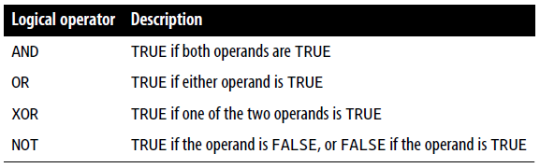
Logical operators
Logical operators produce true-or-false results, and therefore are also known as Boolean operators. There are four of them:

Slide 37
Logical operators
<?php
$a = 1; $b = 0;
echo ($a AND $b) . "<br>";
echo ($a or $b) . "<br>";
echo ($a XOR $b) . "<br>";
echo !$a . "<br>";
?>
Note that the ! symbol is required by PHP in place of NOT
Furthermore, the operators can be lower- or uppercase
Remember that AND and OR have lower precedence than the other versions of the operators, && and ||

Slide 38
Logical operators
<?php
$a = 1; $b = 0;
echo ($a AND $b) . "<br>";
echo ($a or $b) . "<br>";
echo ($a XOR $b) . "<br>";
echo !$a . "<br>";
?>
This example outputs NULL, 1, 1, NULL, meaning that only the second and third echo statements evaluate as TRUE. (Remember that NULL—or nothing—represents a value of FALSE.)

Slide 39
hmmm
<?php
if ($finished == 1 OR getnext() == 1) exit;
?>
What’s the problem here?
Notes:
This is also called “short-circuit”

Slide 40
Logical operators
The OR operator can cause unintentional problems in if statements, because the second operand will not be evaluated if the first is evaluated as TRUE.
In this example, the function getnext will never be called if $finished has a value of 1
<?php
if ($finished == 1 OR getnext() == 1) exit;
?>
Notes:
This is also called “short-circuit”

Slide 41
Logical operators
If you need getnext to be called at each if statement, you could rewrite the code like this:
<?php
$gn = getnext();
if ($finished == 1 OR $gn == 1) exit;
?>
In this case, the code in function getnext will be executed and the value returned stored in $gn before the if statement.

Slide 42
Conditionals
Conditionals are central to dynamic web pages because they make it easy to create different output each time a page is viewed.
There are three types of non-looping conditionals:
The if statement
The switch statement
The ? operator

Slide 43
Conditionals
<?php
if ($bank_balance < 100)
{
$money = 1000;
$bank_balance += $money;
}
?>
…
In this example, you are checking your balance to see whether it is less than 100 dollars (or whatever your currency is). If so, you pay yourself 1,000 dollars and then add it to the balance. (If only making money were that simple!)
If the bank balance is 100 dollars or greater, the conditional statements are ignored and program flow skips to the next line (not shown)

Slide 44
Conditionals
<?php
if ($bank_balance < 100)
{
$money = 1000;
$bank_balance += $money;
}
else
{
$savings += 50;
$bank_balance -= 50;
}
?>
In this example, now that you’ve ascertained that you have $100 or more in the bank, the else statement is executed, by which you place some of this money into your savings account.
An else statement closes either an if...else or an
if...elseif...else statement.
You can leave out a final else if it is not required, but you cannot have one before an elseif; neither can you have an elseif before an if statement.

Slide 45
Conditionals
<?php
if ($page == "Home") echo "You selected Home";
elseif ($page == "About") echo "You selected About";
elseif ($page == "News") echo "You selected News";
elseif ($page == "Login") echo "You selected Login";
elseif ($page == "Links") echo "You selected Links";
?>
Maybe with a switch statement it would look better… but check with your supervisor!

Slide 46
<?php
switch ($page) {
case "Home": echo "You selected Home";
break;
case "About": echo "You selected About";
break;
case "News": echo "You selected News";
break;
case "Login": echo "You selected Login";
break;
case "Links": echo "You selected Links";
break;
default: echo "Unrecognized selection";
break;
}
?>
Of course, in a real program you would have code here to display or jump to a page, rather than simply telling the user what was selected…

Slide 47
<?php
switch ($page) :
case "Home": echo "You selected Home";
break;
// etc...
case "Links": echo "You selected Links";
break;
endswitch;
?>
If you prefer, you may replace the first curly brace in a switch statement with a single colon, and the final curly brace with an endswitch command
However, this approach is not commonly used and is mentioned here only in case you encounter it in third-party code

Slide 48
One way of avoiding the verbosity of if and else statements is to use the more compact ternary operator, ?, which is unusual in that it takes three operands rather than the typical two.
<?php
echo $fuel <= 1 ? "Fill tank now" : "There's enough fuel";
?>
In this statement, if there is one gallon or less of fuel (in other words, $fuel is set to 1 or less), the string “Fill tank now” is returned to the preceding echo statement. Otherwise, the string “There's enough fuel” is returned.
You can also assign the value returned in a ? statement to a variable:
<?php
$enough = $fuel <= 1 ? FALSE : TRUE;
?>

Slide 49
Looping
while loop to print the “12 times” table
<?php
$count = 1;
while ($count <= 12)
{
echo "$count times 12 is " . $count * 12 . "<br>";
++$count;
}
?>

Slide 50
Looping
A shortened version
<?php
$count = 0;
while (++$count <= 12)
echo "$count times 12 is " . $count * 12 . "<br>";
?>

Slide 51
Looping
A do...while loop for printing the times table for 12:
<?php
$count = 1;
do {
echo "$count times 12 is " . $count * 12 . "<br>";
++$count;
}
while ($count <= 12);
?>

Slide 52
Looping
Outputting the times table for 12 from a for loop:
<?php
for ($count = 1 ; $count <= 12 ; $count++)
echo "$count times 12 is " . $count * 12 . "<br>";
?>
initialization expression ; condition expression ; modification expression

Slide 53
Breaking Out of a Loop
Writing a file using a for loop with error trapping:
<?php
$fp = fopen("text.txt", 'wb’);
for ($j = 0 ; $j < 100 ; ++$j)
{
$written = fwrite($fp, "data");
if ($written == FALSE) break;
}
fclose($fp);
?>
The first line opens the file text.txt for writing in binary mode
Then returns a pointer to the file in the variable $fp, which is used later to refer to the open file

Slide 54
Breaking Out of a Loop
Writing a file using a for loop with error trapping:
<?php
$fp = fopen("text.txt", 'wb’);
for ($j = 0 ; $j < 100 ; ++$j)
{
$written = fwrite($fp, "data");
if ($written == FALSE) break;
}
fclose($fp);
?>
$written is assigned a value by the fwrite function representing the number of characters correctly written.
But if there is an error, the fwrite function assigns the value FALSE.

Slide 55
Breaking Out of a Loop
The break command is even more powerful than you might think, because if you have code nested more than one layer deep that you need to break out of, you can follow the break command with a number to indicate how many levels to break out of:
break 2;

Slide 56
The continue Statement
The continue statement instructs PHP to stop processing the current loop and to move right to its next iteration.
So, instead of breaking out of the whole loop, PHP exits only the current iteration.
<?php
$j = 10;
while ($j > -10)
{
$j--;
if ($j == 0) continue;
echo (10 / $j) . "<br>";
}
?>
For all values of $j between 10 and –10, with the exception of 0, the result of calculating 10 divided by $j is displayed. But for the case of $j being 0, the statement continue is issued and execution skips immediately to the next iteration of the loop.

Slide 57
Implicit and Explicit Casting
PHP is a loosely typed language that allows you to declare a variable and its type simply by using it.
It also automatically converts values from one type to another whenever required. This is called implicit casting.
<?php
$a = 56;
$b = 12;
$c = $a / $b;
echo $c;
?>
By default, PHP converts the output to floating point so it can give the most precise value—4.66 recurring.

Slide 58
Implicit and Explicit Casting
But what if we had wanted $c to be an integer instead?
There are various ways in which we could achieve this, one of which is to force the result of $a/$b to be cast to an integer value using the integer cast type (int), like this:
$c = (int) ($a / $b);
This is called explicit casting.
Note that in order to ensure that the value of the entire expression is cast to an integer, we place the expression within parentheses. Otherwise, only the variable $a would have been cast to an integer
… and this would have been actually pointless, as the division by $b would still have returned a floating-point number…

Slide 59
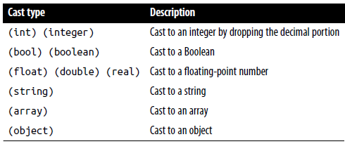
Implicit and Explicit Casting
You can explicitly cast to the types shown below
Or you can call one of PHP’s built-in functions
For example, to obtain an integer value, you could use the intval function

